Slide 1
Spec Request Form

Slide 2
Spec Request Form
What if I told you…

Slide 3

Spec Request Form
Why use the Spec Request Form?
It’s laid out in the same order as Quote Writer
It will que you on often overlooked items as you work through the form
You will get the specification close to what they actually want the first time, rather than doing dozens of revisions.
The form can eliminate costly mistakes

Slide 4

Spec Request Form
When to use the Spec Request Form?
Putting together an initial spec
Reviewing a customers “Punch List”
Reviewing a competitors bid spec

Slide 5
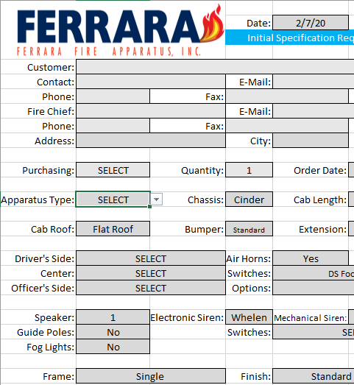
Spec Request Form
How to use the Spec Request Form?
Fill Out Customer Information
Follow the drop boxes to add items and feature to build-up.
Add additional notes in the notes sections items for items not listed
The form is almost dummy proof
Spec Request Forms

Slide 6

Spec Request Form

Slide 7
Intro to Quote Writer

Slide 8

Intro to Quote Writer
What you need to know before you get started…

Slide 9

Intro to Quote Writer
#1 Customer Info
Buying Authorities Actual Name
Their physical address
Primary Contact
Contact Information

Slide 10

Intro to Quote Writer
#2 Apparatus Type
Pumper, Tanker, Aerial, Etc.
Custom or Commercial
SM, TM, RM or No Pump
Materials Preference

Slide 11

Intro to Quote Writer
#3 Apparatus Details
Ladder Location
Engine Size
Cab Size
Wiring Preference
4x2 or 4x4

Slide 12
Intro to Quote Writer
Let’s Start a Quote!

Slide 13

Intro to Quote Writer

