Slide 1


2023 Sales Training

Slide 2
Getting Started
Obtaining a Quote Writer Key:
Innovative MicroSystems, Inc.
Contact: Isabel Stevenson
302-629-4620

Slide 3
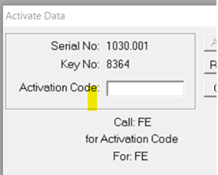
Getting Started
Step 1: Call Isabel
There is a yearly subscription fee and an activation fee that will be due up front
Step 2: Download Quote Writer
Once the fees are paid, Isabel will email you a link to the Quote Write data. Click on the link and download the Quote Write Data to your computer.
Step 3: Download the Ferrara Data
The Ferrara data is available on the Sales Hub under “DOWNLOADS”
Step 4: Activate the Data
Once you download the Ferrara data, you will be prompted for an Activation Code. EMAIL a screenshot of the Serial Number and Key No. to EricA@ferrarafire.com or JohnS@ferrarafire.com
***Activation Codes will be given Monday – Friday, 8am – 5pm Central Time Zone
***It gives you 5 days notice of expiration, don’t wait until the last day!

Slide 4

Intro to Quote Writer
What you need to know before you start a Quote…

Slide 5

Intro to Quote Writer
#1 Customer Info
Buying Authorities Actual Name
Their physical address
Primary Contact
Contact Information

Slide 6

Intro to Quote Writer
#2 Apparatus Type
Pumper, Tanker, Aerial, Etc.
Custom or Commercial

Slide 7

Intro to Quote Writer
#3 Apparatus Details
Ladder Location
Engine Size
Cab Size
Wiring Preference
4x2 or 4x4

Slide 8
Intro to Quote Writer
Let’s Start a Quote!

Slide 9
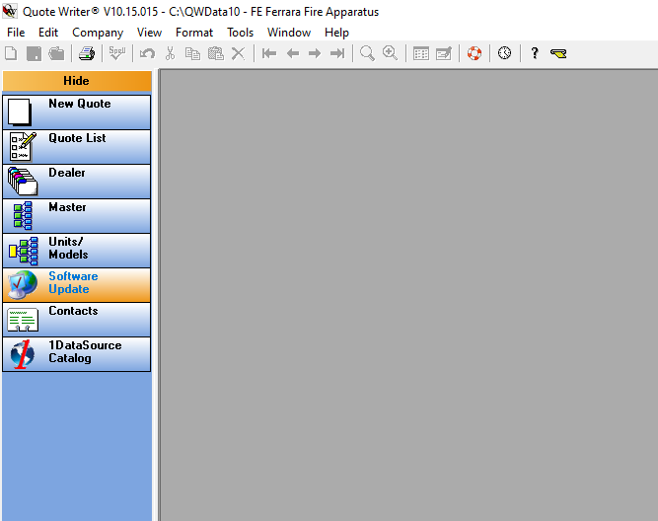
Intro to Quote Writer
Upper Left-Hand Corner of Screen, Select “New Quote”

Slide 10
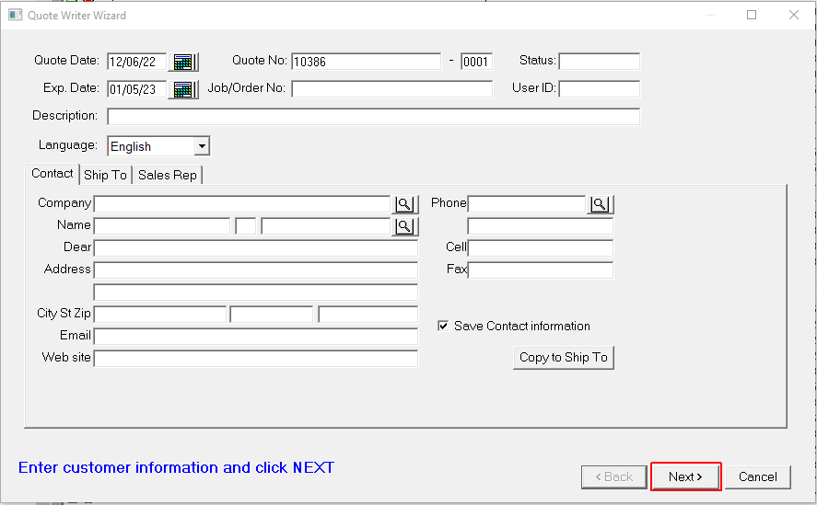
Intro to Quote Writer
This will prompt the Quote Writer Wizard
Step 1: Fill Out the Description
Step 2: Fill Out the Customer Information

Slide 11
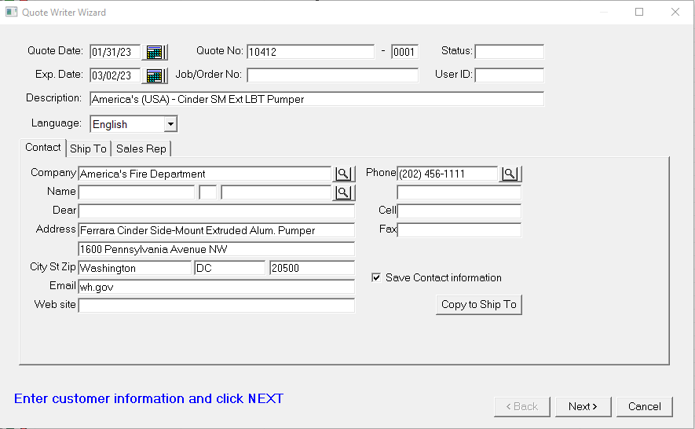
Intro to Quote Writer
Pro Tips!
For the description, put who it’s for and what it is
Fill-Out the customer information completely, this will put there contact info at your fingertips
Putting what the apparatus is in the 1st address line prints this information at the top of the long spec

Slide 12
Intro to Quote Writer
Quote Writer Wizard
Step 3: Click on the “Ship To” tab

Slide 13
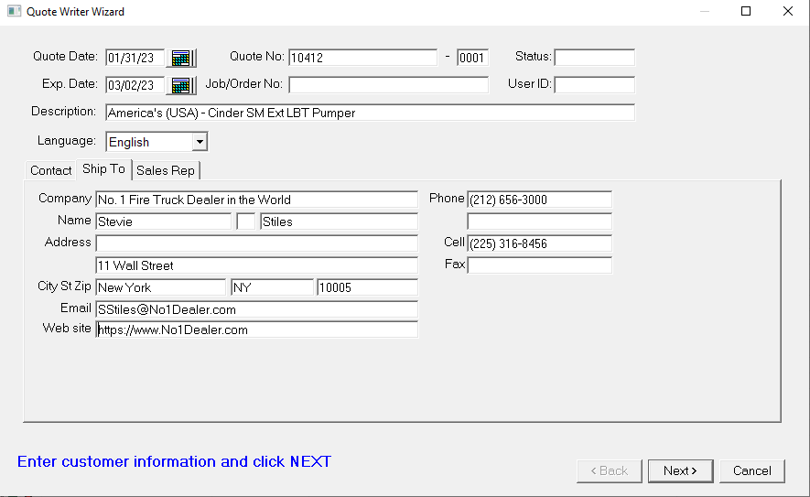
Intro to Quote Writer
Quote Writer Wizard
Step 3 Continued
Fill out YOUR dealership and contact info

Slide 14
Intro to Quote Writer
Quote Writer Wizard
Step 4: Hit the “NEXT” button

Slide 15
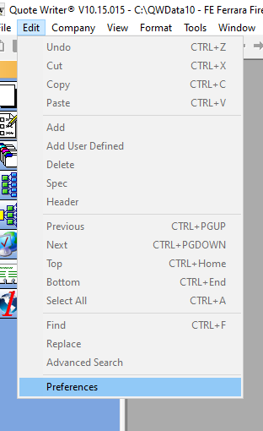
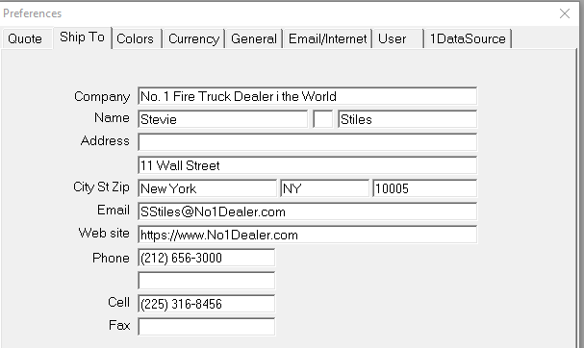
Intro to Quote Writer
PRO TIP!
You can actually save the Ship To information QW so you don’t have to fill it out every time!
Edit
Preference
Ship To tab

Slide 16
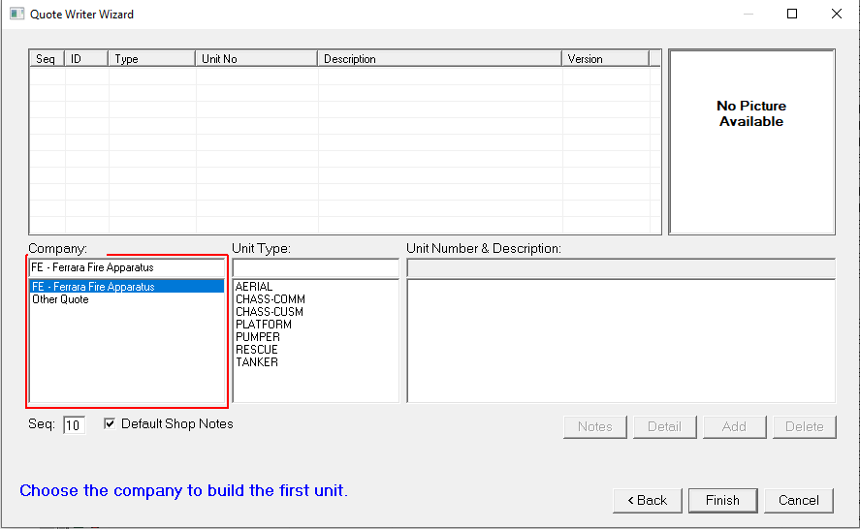
Intro to Quote Writer
Quote Writer Wizard
Step 5: Define What You’re Building
Choices Are:
Aerial
Platform
Pumper
Rescue
Tanker
For this training, I’ll select PUMPER

Slide 17
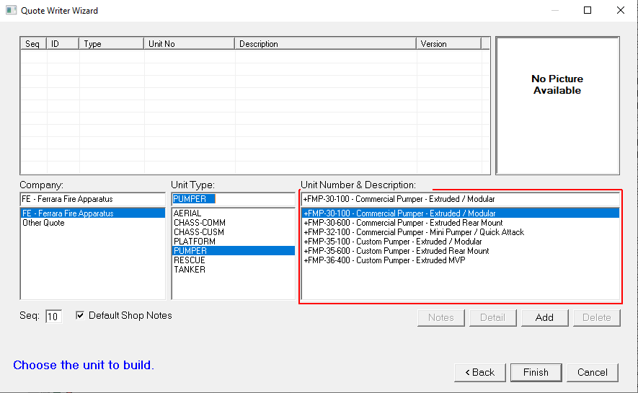
Intro to Quote Writer
Quote Writer Wizard
Step 6: Define Custom or Commercial
***MVP’s are at the bottom

Slide 18
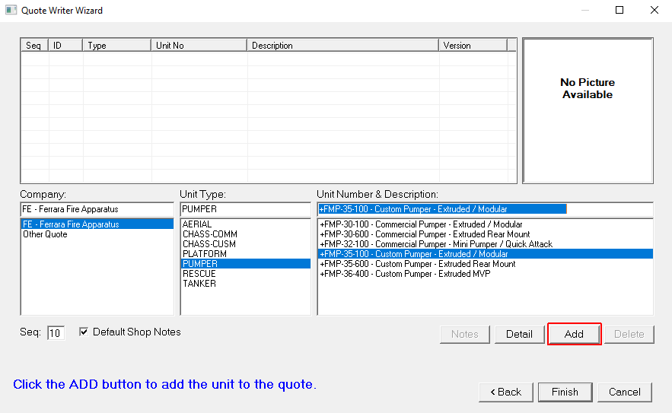
Intro to Quote Writer
Quote Writer Wizard
For today’s training, I’m going to
select a Custom Extruded
Step 7: Select “ADD”
***If you skip Step 7, a completely
blank quote will load, and you have
to start over!

Slide 19
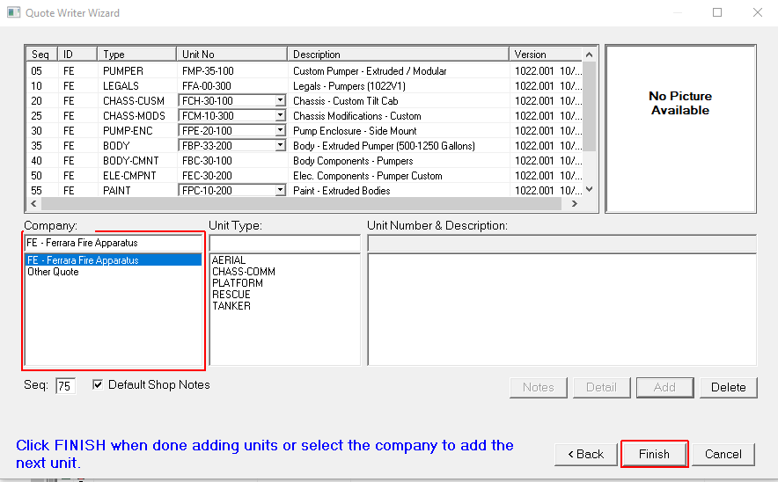
Intro to Quote Writer
Quote Writer Wizard
Once you select “ADD” in step 7, we’re still not done.
The wizard will build the quote for you, BUT:
Step 8: This is where you select 2x4 or 4x4
Step 9: This is where you select SM or TM
Step 10: This is where you select Extruded or Mod.
Step 11: This is where you select the Paint for Extruded or Modular

Slide 20
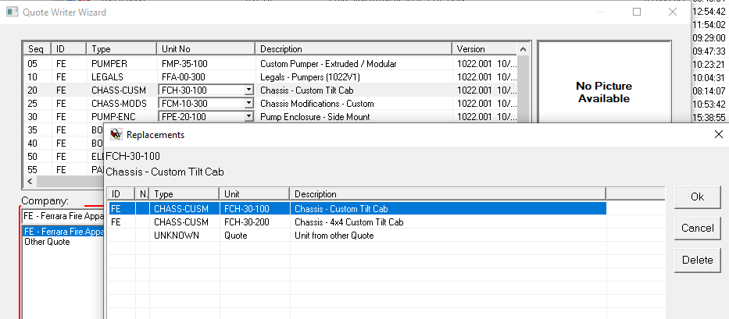
Intro to Quote Writer
4x4 Chassis Selection:

Slide 21
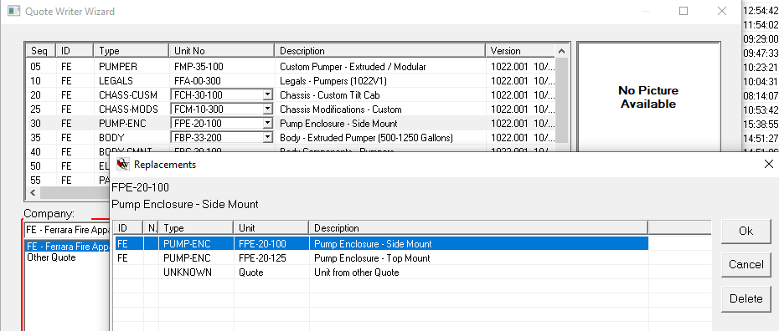
Intro to Quote Writer
Pump Layout:
Side Mount or Top Mount

Slide 22
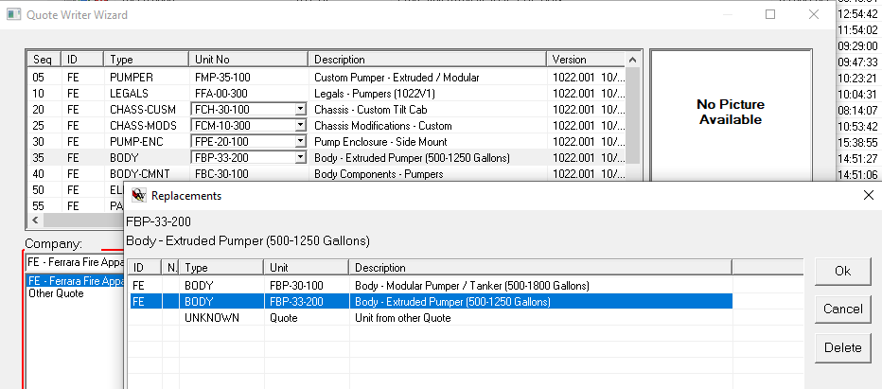
Intro to Quote Writer
Extruded or Modular:

Slide 23
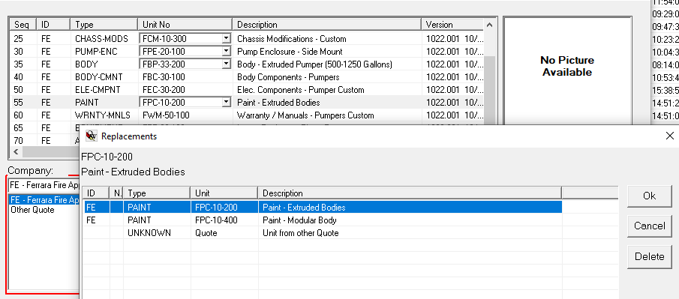
Intro to Quote Writer
Paint Selection:

Slide 24
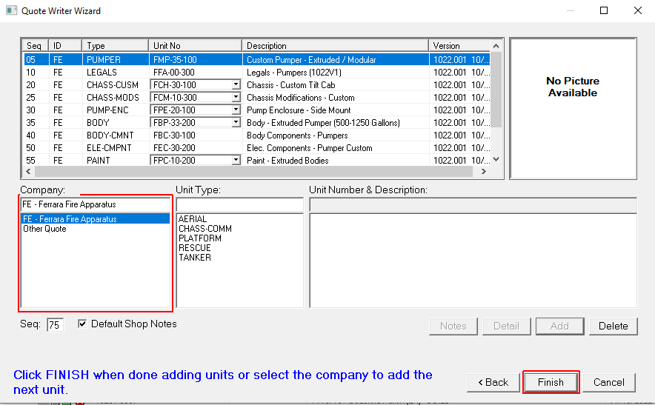
Intro to Quote Writer
Quote Writer Wizard
Step 12: Once you’ve made sure your Wizard
is set up correctly, select “FINISH”

Slide 25
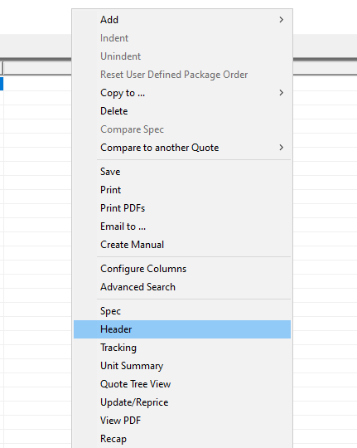
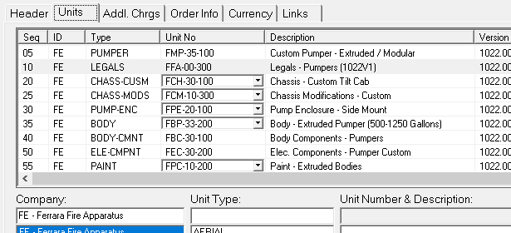
Intro to Quote Writer
PRO TIP!
If you ever need to get back to the Wizard: Step 1, right click in the quote and select “Header” and Step 2, select the “Units” tab.

Slide 26
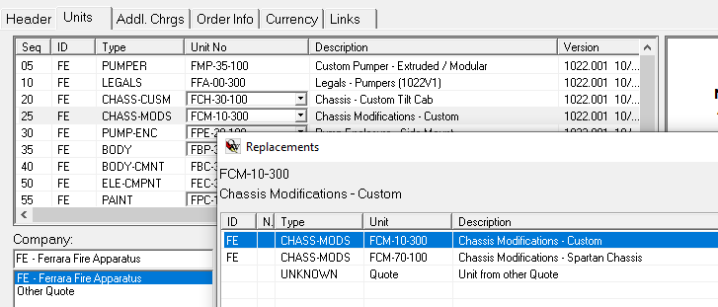
Intro to Quote Writer
PRO TIP!
If you happen to be building a FC-94 or Invader, this is where you pick up the available chassis mods for Spartan chassis

Slide 27

Intro to Quote Writer

Slide 28
Intro to Quote Writer
FOUR BASIC FUNCTIONS IN QUOTE WRITER
Drop Boxes
Add Boxes
2. User Defined Parts (Items needing modification or Items not in Quote Writer)
3. Dealer Parts (Frequently Used User Defined Parts)

Slide 29
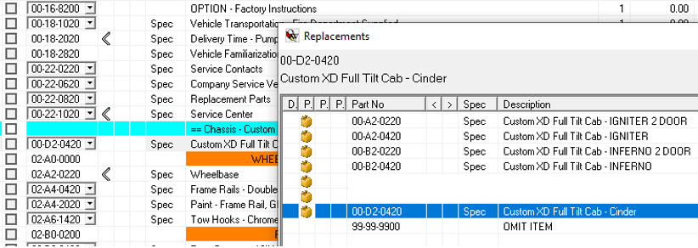
Intro to Quote Writer
FOUR BASIC FUNCTIONS IN QUOTE WRITER
Drop Boxes
The next few steps you’ll do in the quote are based completely on Drop Boxes.
I recommend you do these things FIRST, before anything else!
Step 13: Specify what chassis you’re building
(Cinder/Igniter/Inferno) Line Item 02-D2-0420
OR
Step 13: Specify what Commercial Chassis you’re using
(2-Door, 4-Door, FL, IH, Etc.)
OR
Step 13: OMIT the custom chassis to import a
FC-94/Invader
***For this training we’re building a Cinder

Slide 30
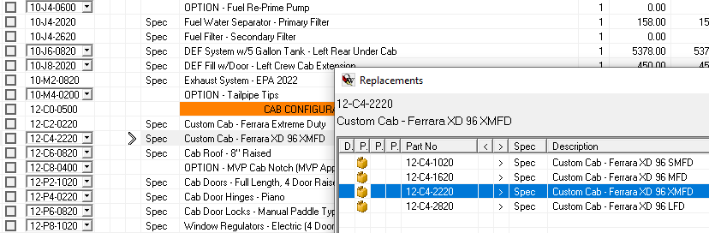
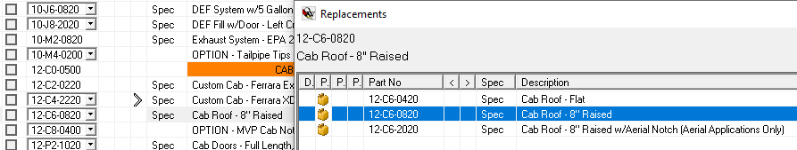
Intro to Quote Writer
FOUR BASIC FUNCTIONS IN QUOTE WRITER
Drop Boxes
The next few steps you’ll do in the quote are based completely on Drop Boxes.
I recommend you do these things FIRST, before anything else!
Step 14/15: Specified the Cab Length and Roof Size
(These is a package items/many items attached to them

Slide 31
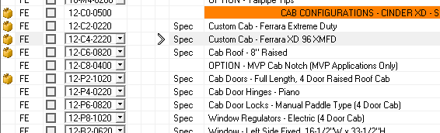
Intro to Quote Writer
PRO TIP!
How do you recognize “Package Items”?
Never, EVER, delete one of the items!

Slide 32
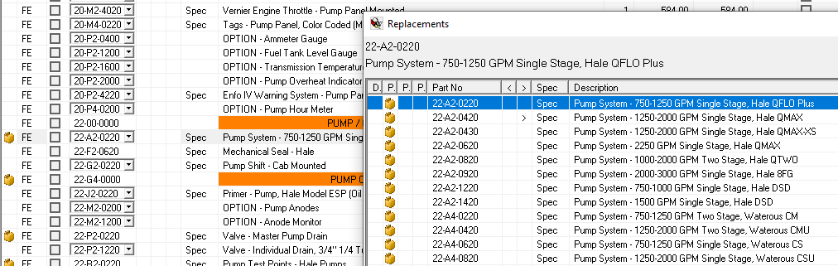
Intro to Quote Writer
FOUR BASIC FUNCTIONS IN QUOTE WRITER
Drop Boxes
The next few steps you’ll do in the quote are based completely on Drop Boxes.
I recommend you do these things FIRST, before anything else!
Step 16: Specified the Pump Make/Model
(This is a package item with a lot of things
attached to it)

Slide 33
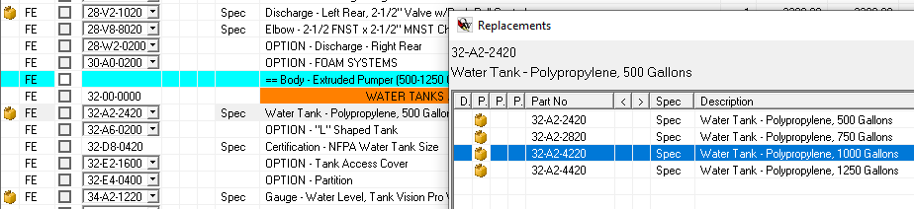
Intro to Quote Writer
FOUR BASIC FUNCTIONS IN QUOTE WRITER
Drop Boxes
The next few steps you’ll do in the quote are based completely on Drop Boxes.
I recommend you do these things FIRST, before anything else!
Step 17: Specify the Water Tank Size
(This is a package item with a lot of things
attached to it)

Slide 34
Intro to Quote Writer
FOUR BASIC FUNCTIONS IN QUOTE WRITER
Drop Boxes
The next few steps you’ll do in the quote are based completely on Drop Boxes.
I recommend you do these things FIRST, before anything else!
Step 17: Specify the Water Tank Size
(This is a package item with a lot of things
attached to it)

Slide 35
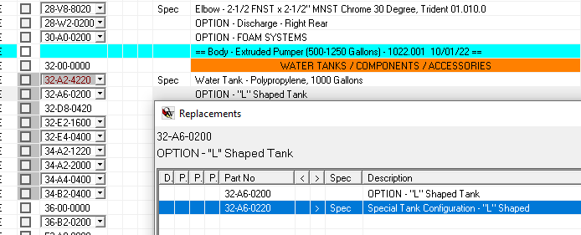
Intro to Quote Writer
FOUR BASIC FUNCTIONS IN QUOTE WRITER
Drop Boxes
The next few steps you’ll do in the quote are based completely on Drop Boxes.
I recommend you do these things FIRST, before anything else!
Step 17-1: Specify the Water Tank Type
(If you want on “L” shape tank, don’t
forget to pic it up!)

Slide 36
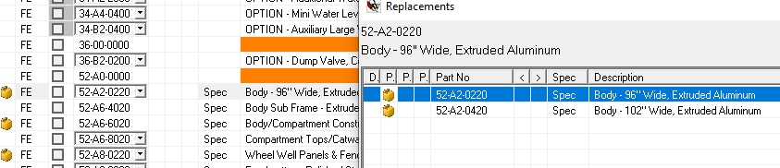
Intro to Quote Writer
FOUR BASIC FUNCTIONS IN QUOTE WRITER
Drop Boxes
The next few steps you’ll do in the quote are based completely on Drop Boxes.
I recommend you do these things FIRST, before anything else!
Step 18: Specify 96” or 102” Wide Body

Slide 37
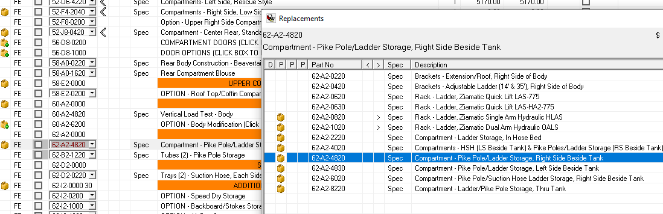
Intro to Quote Writer
FOUR BASIC FUNCTIONS IN QUOTE WRITER
Drop Boxes
The next few steps you’ll do in the quote are based completely on Drop Boxes.
I recommend you do these things FIRST, before anything else!
Step 18: Specify the Ladder Location

Slide 38
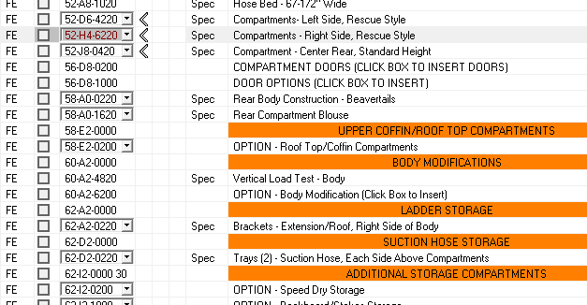
Intro to Quote Writer
PRO TIP!
Pay attention when you're selecting the body/ladder location
QW is intuitive, but its not fool proof!
This DOES NOT work

Slide 39
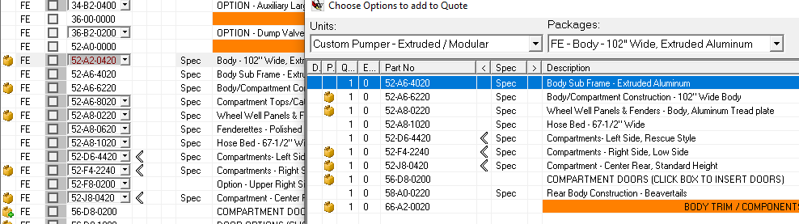
Intro to Quote Writer
A LOOK BEHIND THE CURTAIN
Why should you follow these steps first?
If I had gone though and completely customized the body, and THEN remembered it was a 102” wide body, QW will “reset” all of these items when I go back and update the body to 102” wide

Slide 40
Intro to Quote Writer
FOUR BASIC FUNCTIONS IN QUOTE WRITER
2. Add Boxes
There are item in QW which are going to require you to make a selection, such as: 12-Volt accessories, MIV Valves, Body Doors, Body Door Accessories, Compartment Accessories, etc. They can be found at the Add Boxes.
If you do not make a selection, these items will not be included in your quote.

Slide 41
Intro to Quote Writer
FOUR BASIC FUNCTIONS IN QUOTE WRITER
2. Add Boxes
There are item in QW which are going to require you to make a selection, such as: 12-Volt accessories, MIV Valves, Body Doors, Body Door Accessories, Compartment Accessories, etc. They can be found at the Add Boxes. All you have to do is Left Click on the Plus Sign.
If you do not make a selection, these items will not be included in your quote.

Slide 42
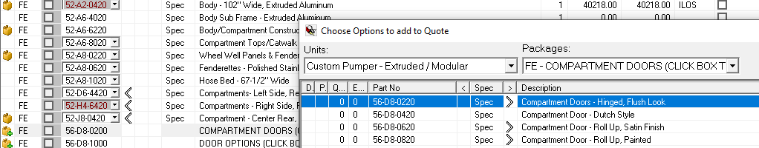
Intro to Quote Writer
FOUR BASIC FUNCTIONS IN QUOTE WRITER
2. Add Boxes
Example: Body Doors

Slide 43
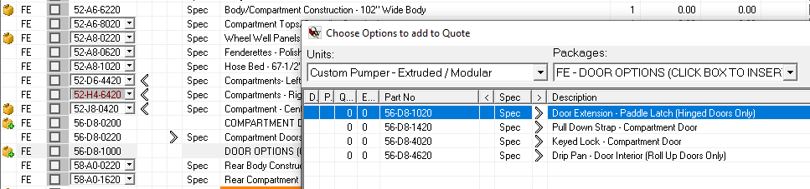
Intro to Quote Writer
FOUR BASIC FUNCTIONS IN QUOTE WRITER
2. Add Boxes
Example: Door Options

Slide 44
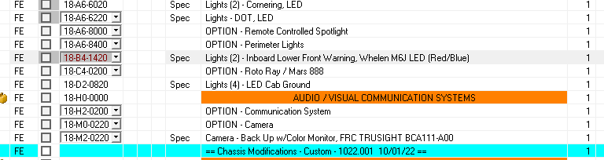
Intro to Quote Writer
FOUR BASIC FUNCTIONS IN QUOTE WRITER
3. User Defined Parts
Use this to modify an existing part or to add items that aren’t in QW
Example: Changing Light Head Colors
I.e. – My customer want Red/White Split front warning lights, not Red/Blue

Slide 45
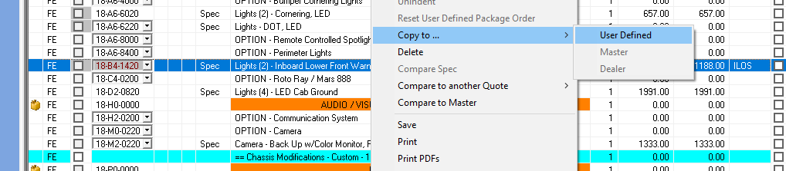
Intro to Quote Writer
FOUR BASIC FUNCTIONS IN QUOTE WRITER
3. User Defined Parts
How to “User Define” an existing part
Step 1: Right click on the part numbers
Step 2: Scroll Up in the Ribbon to “Copy To”
Step 3: Scroll Over in the Ribbon to “User Defined” and Left Click.

Slide 46
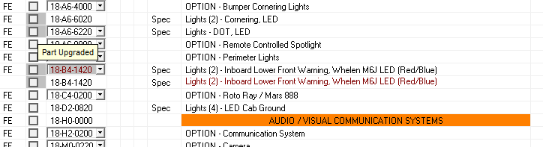
Intro to Quote Writer
FOUR BASIC FUNCTIONS IN QUOTE WRITER
3. User Defined Parts
How to “User Define” an existing part
This will duplicate that part number. The second part number will be RED in color.

Slide 47

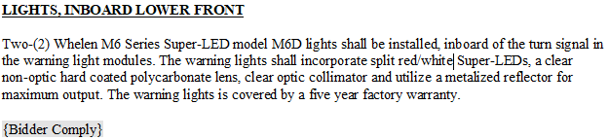
Intro to Quote Writer
FOUR BASIC FUNCTIONS IN QUOTE WRITER
3. User Defined Parts
How to “User Define” an existing part
Next, double click on the Red part number, or press enter when it is highlight, and modify the Long Spec, Header and Shop Note to Reflect the changes

Slide 48
Intro to Quote Writer
FOUR BASIC FUNCTIONS IN QUOTE WRITER
3. User Defined Parts
How to “User Define” an existing part
What do I do with the Original, Black, option that we modified? NOTHING
When you submit all of your User Defined parts on the SPR Form, Eric or Stevie will delete the Original when we do Special Pricing for whatever you modified.

Slide 49
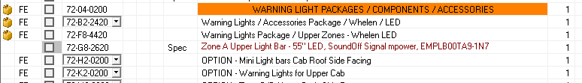
Intro to Quote Writer
FOUR BASIC FUNCTIONS IN QUOTE WRITER
3. User Defined Parts
How to “User Define” a new part number (something that’s not in QW)
Example: A new light bar that’s not in QW yet

Slide 50

Intro to Quote Writer
FOUR BASIC FUNCTIONS IN QUOTE WRITER
3. User Defined Parts
How to “User Define” a new part number
Start off by scrolling down to the Section of the quote you want to add a new part number into. For this example, a Light Bar always goes in the Electrical Components section

Slide 51
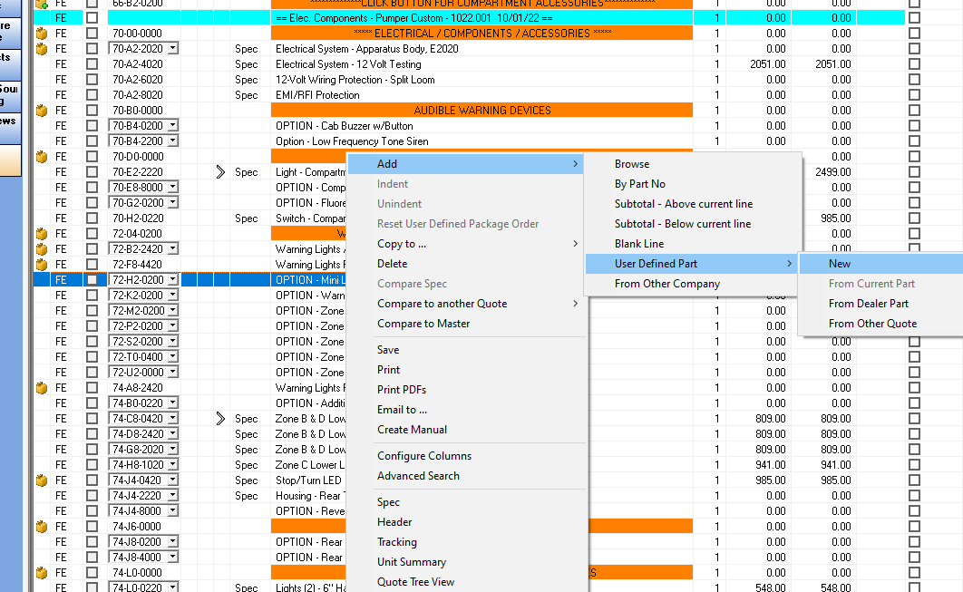
Intro to Quote Writer
FOUR BASIC FUNCTIONS IN QUOTE WRITER
3. User Defined Parts
How to “User Define” a new part number
Once you’re in the section, Right Click, scroll Up in
ribbon to “Add”, and then over to “User Defined”
and then over again to “New”

Slide 52
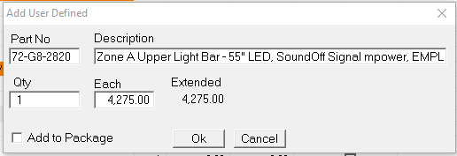
Intro to Quote Writer
FOUR BASIC FUNCTIONS IN QUOTE WRITER
3. User Defined Parts
How to “User Define” a new part number
You’ll then be prompted with the screen.
Fill in the Part No (part number order)
Fill in the Description
Fill in the Each
Click “Ok”

Slide 53
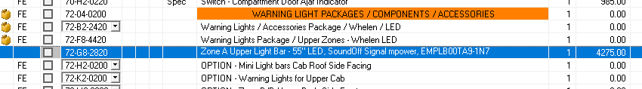
Intro to Quote Writer
FOUR BASIC FUNCTIONS IN QUOTE WRITER
3. User Defined Parts
How to “User Define” a new part number
Now you’ll need to update the Specification. You can click here, double click on the item, or press enter with the item highlighted to open the Long Specification

Slide 54
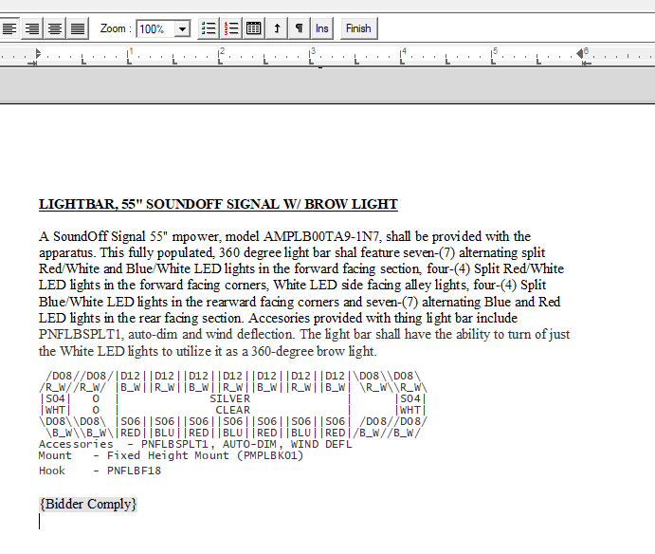
Intro to Quote Writer
FOUR BASIC FUNCTIONS IN QUOTE WRITER
3. User Defined Parts
How to “User Define” a new part number
Next step is to insert your
User Defined specification into
the Long Spec

Slide 55
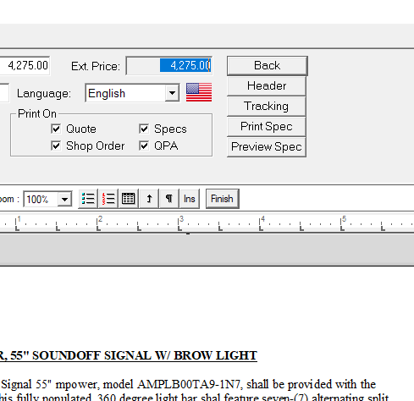
Intro to Quote Writer
FOUR BASIC FUNCTIONS IN QUOTE WRITER
3. User Defined Parts
How to “User Define” a new part number
After you’re done inserting the
Long Specification, Click “Back”
And when prompted to Save,
Select “Yes”

Slide 56
Intro to Quote Writer
FOUR BASIC FUNCTIONS IN QUOTE WRITER
3. User Defined Parts
How to “User Define” a new part number
Congratulations! You’ve just created your own part number!

Slide 57
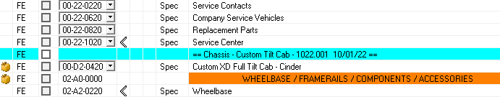
Intro to Quote Writer
FOUR BASIC FUNCTIONS IN QUOTE WRITER
4. Dealer Parts
Dealer Parts are designed for frequently used “User Defined” parts.
Great Example: Service Center Info!
***You can only create “Dealer Parts” from
parts that are already “User Defined”

Slide 58
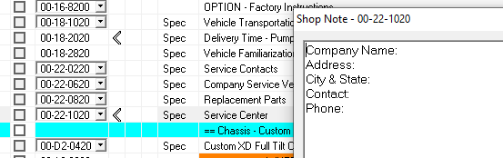
Intro to Quote Writer
FOUR BASIC FUNCTIONS IN QUOTE WRITER
4. Dealer Parts
Dealer Parts are designed for frequently used “User Defined” parts.
Great Example: Service Center Info!
Why? So, you don’t have to type it out
Every Single Time!

Slide 59
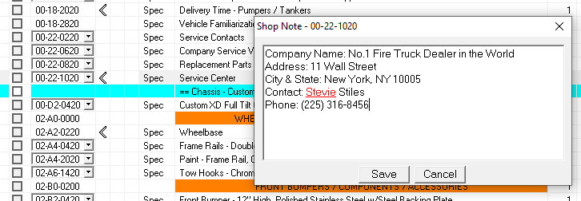
Intro to Quote Writer
FOUR BASIC FUNCTIONS IN QUOTE WRITER
4. Dealer Parts
Dealer Parts are designed for frequently used “User Defined” parts.
First Step – Fill Out the Information
Second Step – Click Save

Slide 60
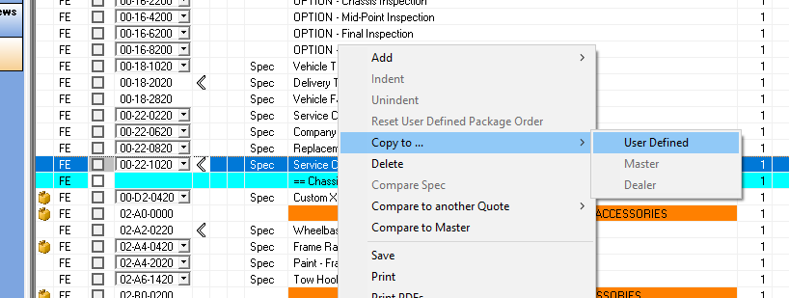
Intro to Quote Writer
FOUR BASIC FUNCTIONS IN QUOTE WRITER
4. Dealer Parts
Dealer Parts are designed for frequently used “User Defined” parts.
Third Step– Copy to User Defined

Slide 61
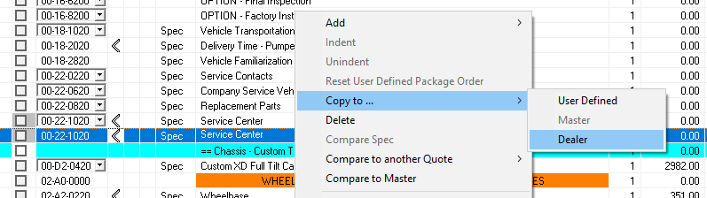
Intro to Quote Writer
FOUR BASIC FUNCTIONS IN QUOTE WRITER
4. Dealer Parts
To Create a Dealer Part:
Fourth Step - Right Click on a “User Defined” Part
Fifth Step - Scroll Up to “Copy to” and over to “Dealer

Slide 62
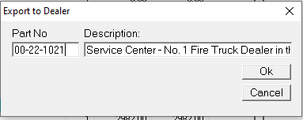
Intro to Quote Writer
FOUR BASIC FUNCTIONS IN QUOTE WRITER
4. Dealer Parts
You’ll be prompted to “Export to Dealer”. Click “Ok”

Slide 63
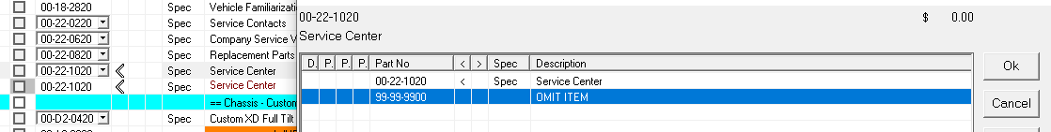
Intro to Quote Writer
FOUR BASIC FUNCTIONS IN QUOTE WRITER
4. Dealer Parts
Don’t forget to OMIT the original one!

Slide 64
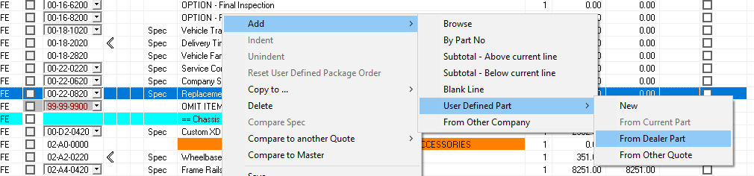
Intro to Quote Writer
FOUR BASIC FUNCTIONS IN QUOTE WRITER
4. Dealer Parts
Now that you’ve created a “Dealer Part”, you can import that part number without having to re-type everything!
Right Click where the part goes
Scroll Up to “Add”
Scroll Over to User “Defined Part”
Over again to “From Dealer Part”

Slide 65

Intro to Quote Writer
FOUR BASIC FUNCTIONS IN QUOTE WRITER
4. Dealer Parts
Once you follow those steps, you’ll be prompted to add a part from YOUR dealer parts catalog. Double click on the item, and select “Ok”
*** I have A LOT of “Dealer Parts”. YOURS
may not look like this yet, but you’ll get there

Slide 66

Intro to Quote Writer
FOUR BASIC FUNCTIONS IN QUOTE WRITER
4. Dealer Parts
VOILÀ

Slide 67
Intro to Quote Writer

Slide 68

FC-94 / Invader Chassis
FC-94/INVADER CHASSIS IMPORTATION INTO QW

Slide 69

FC-94 / Invader Chassis
FC-94/INVADER CHASSIS IMPORTATION INTO QW
Step 1: Prepare the QW File
  Start by “OMIT”ing the chassis

Slide 70

FC-94 / Invader Chassis
FC-94/INVADER CHASSIS IMPORTATION INTO QW
Step 2: Create a User Defined Part for the Chassis

Slide 71

FC-94 / Invader Chassis
FC-94/INVADER CHASSIS IMPORTATION INTO QW
Step 3: Make Sure the Chassis Quote is “Clean”
There should be NO “N/A”s

Slide 72

FC-94 / Invader Chassis
FC-94/INVADER CHASSIS IMPORTATION INTO QW
Step 3: Make Sure the Chassis Quote is “Clean”
You should ALWAYS select “Driveline Confirmation”

Slide 73

FC-94 / Invader Chassis
FC-94/INVADER CHASSIS IMPORTATION INTO QW
Step 3: Make Sure the Chassis Quote is “Clean”
You should ALWAYS select “3D Bumper Layout”

Slide 74

FC-94 / Invader Chassis
FC-94/INVADER CHASSIS IMPORTATION INTO QW
Step 4: Copy the Chassis Spec
Click on the Scroll in the upper left-hand corner

Slide 75

FC-94 / Invader Chassis
FC-94/INVADER CHASSIS IMPORTATION INTO QW
Step 4: Copy the Chassis Spec
Make sure only “Specification” is Checked, and Print Order is FTBuilder Default, the Click “Print/Preview”

Slide 76

FC-94 / Invader Chassis
FC-94/INVADER CHASSIS IMPORTATION INTO QW
Step 4: Copy the Chassis Spec
Highlight and Copy the whole Chassis Spec
Trick
CTRL+ A
CTRL + C

Slide 77

FC-94 / Invader Chassis
FC-94/INVADER CHASSIS IMPORTATION INTO QW
Step 5: Paste the Chassis Spec into the QW File
Paste the Chassis Spec into your User Defined Part
Trick
CTRL + V

Slide 78

FC-94 / Invader Chassis
FC-94/INVADER CHASSIS IMPORTATION INTO QW
Step 6: Save the Chassis Spec in the QW File
Click “Back” in the upper right and, and then “Yes” when prompted to save

Slide 79

FC-94 / Invader Chassis
FC-94/INVADER CHASSIS IMPORTATION INTO QW
Step 7: Pull the Chassis Price from FTBuilder
Click on the Scroll in the upper left hand corner in FTBuilder

Slide 80

FC-94 / Invader Chassis
FC-94/INVADER CHASSIS IMPORTATION INTO QW
Step 7: Pull the Chassis Price from FTBuilder
Make sure only “Quote Summary” is Checked then Click “Print/Preview”

Slide 81

FC-94 / Invader Chassis
FC-94/INVADER CHASSIS IMPORTATION INTO QW
Step 7: Pull the Chassis Price from FTBuilder
Copy the Chassis Price out of FTBuilder

Slide 82

FC-94 / Invader Chassis
FC-94/INVADER CHASSIS IMPORTATION INTO QW
Step 7: Pull the Chassis Price from FTBuilder
Insert the Chassis Price into your User Defined Part in QW

Slide 83
FC-94 / Invader Chassis
FC-94/INVADER CHASSIS IMPORTATION INTO QW
Step 8: Copy the Chassis Shop Order
Click on the Scroll in the upper left-hand corner

Slide 84

FC-94 / Invader Chassis
FC-94/INVADER CHASSIS IMPORTATION INTO QW
Step 8: Copy the Chassis Shop Order
Make sure only “Quote” is Checked, with sub-categories “Non-Selectable Part Number”, “Part Number” and “Description Checked”
Click “Print/Preview”

Slide 85

FC-94 / Invader Chassis
FC-94/INVADER CHASSIS IMPORTATION INTO QW
Step 9: Paste the Chassis Shop Order
Copy the Shop Order out of FTBuilder
Trick
CTRL+ A
CTRL + C

Slide 86

FC-94 / Invader Chassis
FC-94/INVADER CHASSIS IMPORTATION INTO QW
Step 8: Paste the Chassis Shop Order into the QW File
Paste the Shop Order into the Shop Note of the Chassis

Slide 87

FC-94 / Invader Chassis
FC-94/INVADER CHASSIS IMPORTATION INTO QW
Step 9: Save the Chassis Shop Order into the QW File
Click on “Save” once you’ve pasted the Shop Order into the QW File

Slide 88

FC-94 / Invader Chassis
FC-94/INVADER CHASSIS IMPORTATION INTO QW
Any FC-94/Invader related questions should be directed to Dave Skidmore

Slide 89

Special Pricing Request
SPECIAL PRICE REQUEST (SPR)

Slide 90

Special Pricing Request
SPECIAL PRICING REQUEST (SPR)
Is there a way to sort a Quote File for
User Defined?
YES
Upper left hand Corner: Go to View
Down to Quote Order and Over to
Specials Only

Slide 91

Special Pricing Request
SPECIAL PRICING REQUEST (SPR)
Anything that shows up in this view,
Needs to be on your SPR Form

Slide 92

Special Pricing Request
SPECIAL PRICING REQUEST (SPR)
This is what your SPR Form should look like:

Slide 93
Intro to Quote Writer
SPECIAL PRICING REQUEST (SPR)
Special Notes for Consideration:
SPR Form should include the Part Number and Header only, not the Long Spec or a Short Description. We will pull that information from your QW File.
If the User Definer Part isn’t in the QW File, but it’s on the SPR Form – ITS NOT GETTING PRICED
If there’s a User Defined Part in your QW File, and it’s not on the SPR Form – THE ORDER WON’T BE ACCEPTED
If the Price on the SPR Form doesn’t match the Price in the QW File – THE ORDER WON’T BE ACCEPTED
FFA Can Modify Your Imported Parts, Descriptions or Long Spec. FFA Will Not insert the parts for you – SPR is for Pricing ONLY.

Slide 94

Special Pricing Request
How to submit a SPR Request

Slide 95

Special Pricing Request
SPECIAL PRICING REQUEST (SPR)
Things you will need to submit:
SPR Form (Filled Out Correctly)
QW File

Slide 96

Special Pricing Request
SPECIAL PRICING REQUEST (SPR)
Step 1: Fill Out and Save the SPR Form to your computer

Slide 97

Special Pricing Request
SPECIAL PRICING REQUEST (SPR)
Step 2: Save the QW File to your computer
Right Click on the File in QW
Scroll down in the prompt to “Sent to File”

Slide 98

Special Pricing Request
SPECIAL PRICING REQUEST (SPR)
Step 2: Save the QW File to your computer
When this Prompt appears, make sure “Entire Quote” is selected
Click “Next”

Slide 99

Special Pricing Request
SPECIAL PRICING REQUEST (SPR)
Step 2: Save the QW File to your computer
Save the QW File to the Appropriate Locations

Slide 100


Special Pricing Request
SPECIAL PRICING REQUEST (SPR)
Step 3: Attach the Files to an Email

Slide 101

Special Pricing Request
SPECIAL PRICING REQUEST (SPR)
Step 4: Address the email to YOUR Regional Sales Manager
The Subject Line should capture a summary of this email

Slide 102

Special Pricing Request
SPECIAL PRICING REQUEST (SPR)
Step 5: Fill Out the Body of your detailing what you’re asking for and click Send

Slide 103

Special Pricing Request
SPECIAL PRICING REQUEST (SPR)
Standard turnaround time on a SPR is 10 BUSINESS DAYS
I.e. – March 29th = April 11th
***Extenuating circumstances such as new items or layouts could take more than 10 business day***
1
2
3
4
5
6
7
8
9
10

Slide 104

Special Pricing Request

Slide 105

Drawing Request
DRAWING REQUEST

Slide 106

Drawing Request
DRAWING REQUEST
Things you will need to submit:
Drawing Request Form
QW File
Chassis Quote File (if applicable)

Slide 107

Drawing Request
DRAWING REQUEST
Step 1: Fill Out the Drawing Request Form with ALL pertinent information.
Special Note: If the project isn’t in SalesForce, the Drawing Request isn’t getting processed

Slide 108

Drawing Request
DRAWING REQUEST
Step 2: Save the Drawing Request Form to your computer

Slide 109

Drawing Request
DRAWING REQUEST
Step 3: Save the Chassis Quote to your computer (if applicable)

Slide 110

Drawing Request
DRAWING REQUEST
Step 3: Cont’d – How to Export Files from FTBuilder
Select the File you want to save to your computer and Click “Export”

Slide 111

Drawing Request
DRAWING REQUEST
Step 3: Cont’d – How to Export Files from FTBuilder
Export the File in the appropriate location

Slide 112


Drawing Request
DRAWING REQUEST
Step 4: Attach the Drawing Request Form, QW File and Chassis File (if applicable) to an email

Slide 113

Drawing Request
DRAWING REQUEST
Step 5: Address the email to YOUR Regional Sales Manager
The Subject Line should capture a summary of this email

Slide 114

Drawing Request
DRAWING REQUEST
Step 5: Fill Out the Body of your detailing what you’re asking for and click Send

Slide 115

Drawing Request
DRAWING REQUEST
DO NOT SUBMIT THE FILE THROUGH FTBUILDER, SAVE IT TO YOUR COMPUTER AND ATTACH IT TO AN EMAIL

Slide 116

Drawing Request
DRAWING REQUEST
Standard turnaround time on a Drawing Request is Up To 30 BUSINESS DAYS

Slide 117

Drawing Request

Slide 118

Concession Request Form
CONCESSION REQUEST FORM

Slide 119


Concession Request Form
CONCESSION REQUEST FORM
Step 1: Fill Out
Dealer/Customer Information
Date you’re submitting the request
Date you need the price back by

Slide 120


Concession Request Form
CONCESSION REQUEST FORM
Step 2: Fill Out the Quote Information
***Quote should NOT include dealer money***

Slide 121
Concession Request Form
CONCESSION REQUEST FORM
Step 2: Fill Out the Quote Information (Cont’d)
LEAVE BLANK
10412-0001
1022V1
$530,849

Slide 122

Concession Request Form
CONCESSION REQUEST FORM
Step 3: Check Box Included Information
Cause for Rejection

Slide 123

Concession Request Form
CONCESSION REQUEST FORM
Step 4: Full out details about the Bid/Proposal
If it’s a bid, whose Specs?
If it’s a Proposal = FFA
How many units are they buying RIGHT NOW?
How much are they looking to spend?
Who is the competition?

Slide 124
Concession Request Form
CONCESSION REQUEST FORM
Step 4: Full out details about the Bid/Proposal
(Cont’d)
LEAVE BLANK

Slide 125

Concession Request Form
CONCESSION REQUEST FORM
Things you will need to submit:
Completed Concession Request Form
Matching/Complete QW File
Chassis Quote (if applicable)
Bid Specs (if applicable)

Slide 126


Concession Request Form
CONCESSION REQUEST FORM
Email to YOUR Regional
Sales Manager

Slide 127

Concession Request Form
CONCESSION REQUEST FORM
Standard turnaround time on a Concession Request Form is 10 BUSINESS DAYS
I.e. – Dec. 21, 2022 = January 6, 2023

Slide 128

Concession Request Form

Slide 129

Order Entry
ORDER ENTRY

Slide 130

Order Entry
Order Entry
Step 1: Fill Out Order Entry Form
Leave to top section BLANK

Slide 131


Order Entry
Order Entry
Step 1: Fill Out Order Entry Form
Fill Out Dealership Information
Date of Submission
YOUR Regional Sales Manager
Eric Adams OR Stevie Stiles

Slide 132

Order Entry
Order Entry
Step 1: Fill Out Order Entry Form
Fill Out Purchaser Information

Slide 133

Order Entry
Order Entry
Step 1: Fill Out Order Entry Form
Fill Out Purchaser Information Cont’d
Where does the money come from?

Slide 134


Order Entry
Order Entry
Step 2: Fill Out Checklist

Slide 135

Order Entry
Order Entry
Step 3: Bond Information (if applicable)

Slide 136


Order Entry
Order Entry
Step 4: Delivery and Payment Information

Slide 137

Order Entry
Order Entry
Step 5: Factory Trips

Slide 138

Order Entry
Order Entry
Step 6: Bank/Leasing Info, Legal Status and Driving Instructions

Slide 139

Order Entry
Order Entry
Things you will need to submit:
Contract or PO
Tax Exempt Sheet
Authorized Concession Form
Copy of Customer Bid (if applicable)
List of Bid Exceptions (if applicable)
Complete QW Build File
Special Pricing Form
Commercial/Spartan Chassis Quote (if applicable)
Bank/Leasing Company Contact Info (if applicable)

Slide 140


Order Entry
ORDER ENTRY
Email to YOUR Regional
Sales Manager

Slide 141

2023 Sales Training

